Slide 1


K.RAMAKRISHNAN COLLEGE OF TECHNOLOGY
ONLINE WORKSHOP REGISTRATION AND ATTENDANCE SYSTEM
Presented by:
SRIVARSHINI S – 2303811710422159
SWATHI V – 2303811710422165
YOGESHWARI M - 2303811710422159

Slide 2


ABSTRACT
The Online Workshop Registration and Attendance System is a web-based platform designed to make workshop management easier and faster. Participants can register online by entering their details and selecting their workshop. Event organizers can view the list of registered students and record their attendance, while admins can monitor total registrations and overall attendance reports. The system uses HTML, CSS, and JavaScript with localStorage to store data, making it lightweight and easy to use. This project helps reduce manual work, avoids errors, and provides a smooth and efficient way to manage workshop activities.

Slide 3
INTRODUCTION
Workshops play a vital role in skill development, but managing registrations and attendance manually often causes inefficiency.
This project proposes a digital system that streamlines online workshop registration, event creation, and attendance tracking.
This system offers a user-friendly interface for participants, organizers, and admins, ensuring faster processing, accurate data handling, and improved overall workshop management.

Slide 4
EXISTING SYSTEM
Manual Registration Process: Workshop registrations are usually recorded using paper forms or basic spreadsheets, making the process slow, prone to handwriting errors, and difficult to organize.
No Centralized Platform: Participants, organizers, and admins do not have a unified system, leading to scattered records and difficulty in accessing information when needed.
Inefficient Attendance Tracking: Attendance is marked manually during workshops, which often results in missing entries, duplication, or incorrect data.

Slide 5
PROPOSED SYSTEM
Online platform for workshop registration.
Event organizers can create workshops with online meeting links.
Admin and organizers notified instantly after participant registration.
Manual but controlled attendance entry.
Admin dashboard for real-time monitoring.

Slide 6
MODULES
1. User Authentication Module
2. Participant Registration Module
3. Event Organizer Module
4. Attendance Management Module
5. Admin Dashboard Module

Slide 7
MODULES DESCRIPTION
1. User Authentication Module
This module allows users to select their role—Admin, Event Organizer, or Participant—before entering the system. It ensures each user is routed to the correct interface based on their chosen role.
2. Participant Registration Module
It enables participants to enter their personal and academic details for workshop registration. The module stores all submitted data and confirms successful registration.
3. Event Organizer Module
This module displays the full list of registered participants for the event organizer. It allows organizers to manage and update attendance records easily.

Slide 8
MODULES DESCRIPTION
4. Attendance Management Module
The module handles marking, updating, and storing participant attendance. It ensures accurate attendance information is available for organizers and admins.
5. Admin Dashboard Module
This module provides the admin with complete details of registrations and attendance statistics. It helps in monitoring system data such as total registrations and attendance percentage.

Slide 9
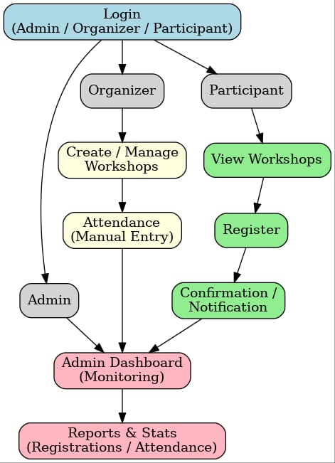
FLOW DIAGRAM

Slide 10
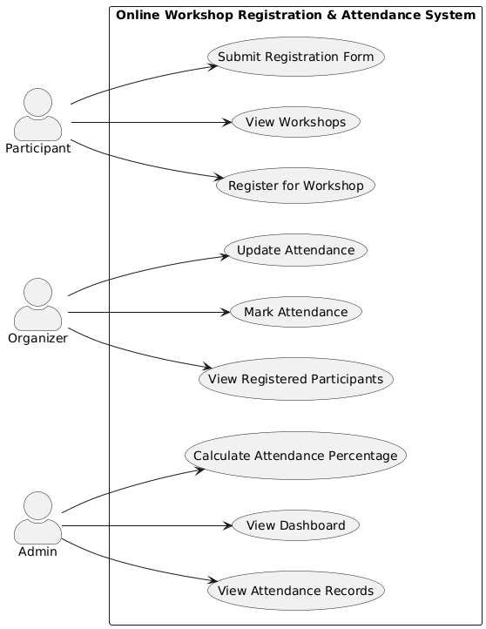
USE CASE DIAGRAM

Slide 11
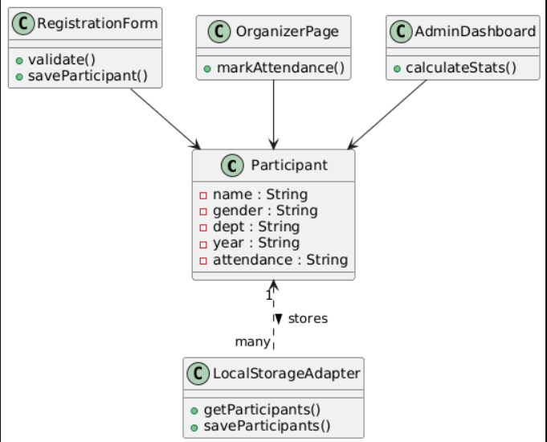
CLASS DIAGRAM

Slide 12
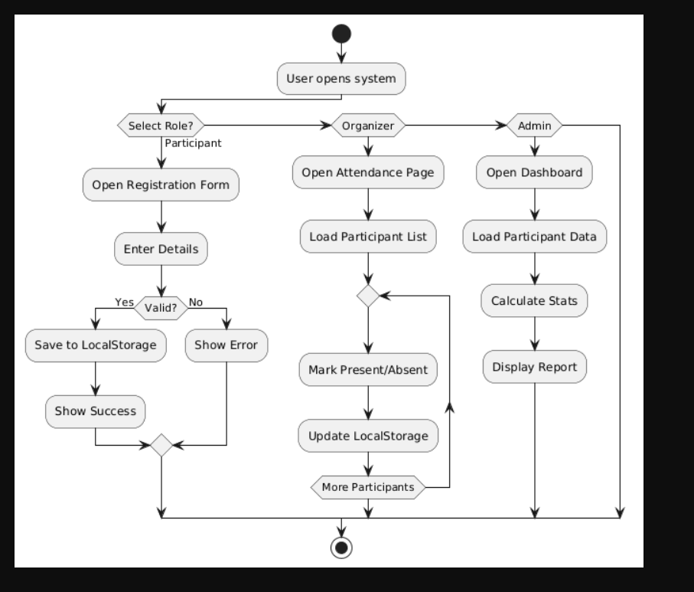
ACTIVITY DIAGRAM

Slide 13
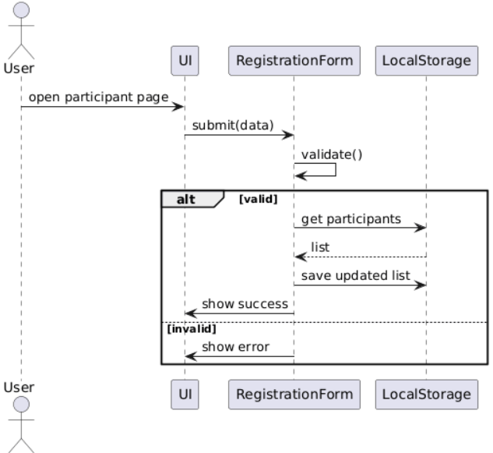
SEQUENCE DIAGRAM

Slide 14
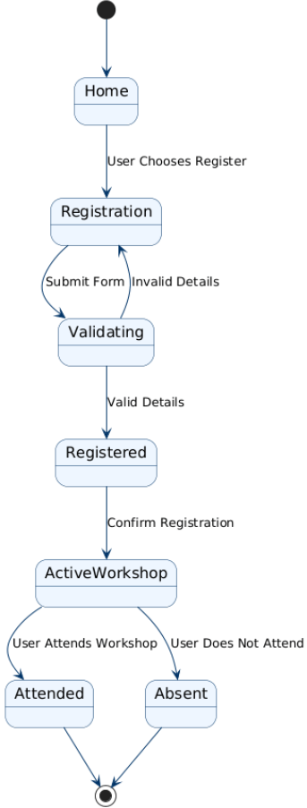
COLLABORATION
DIAGRAM

Slide 15
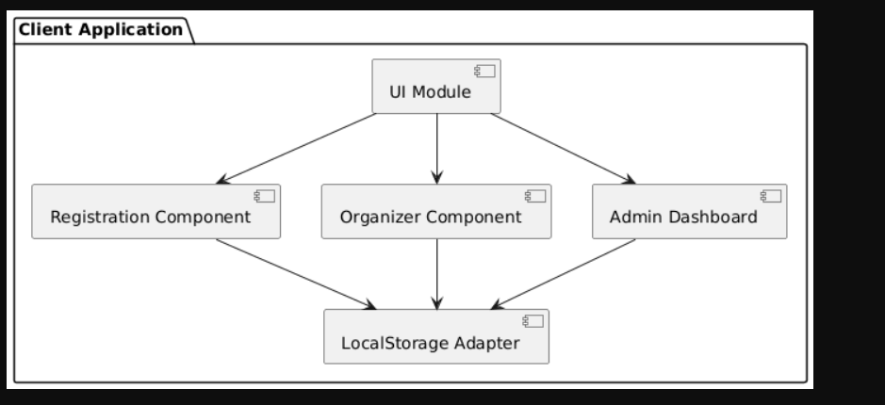
COMPONENT DIAGRAM

Slide 16
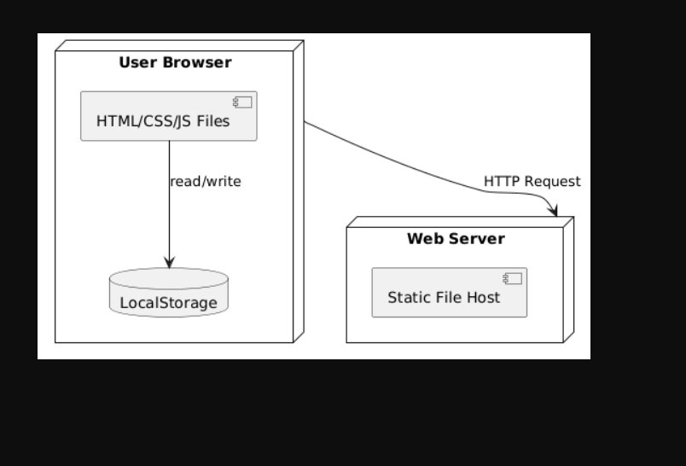
DEPLOYMENT DIAGRAM

Slide 17
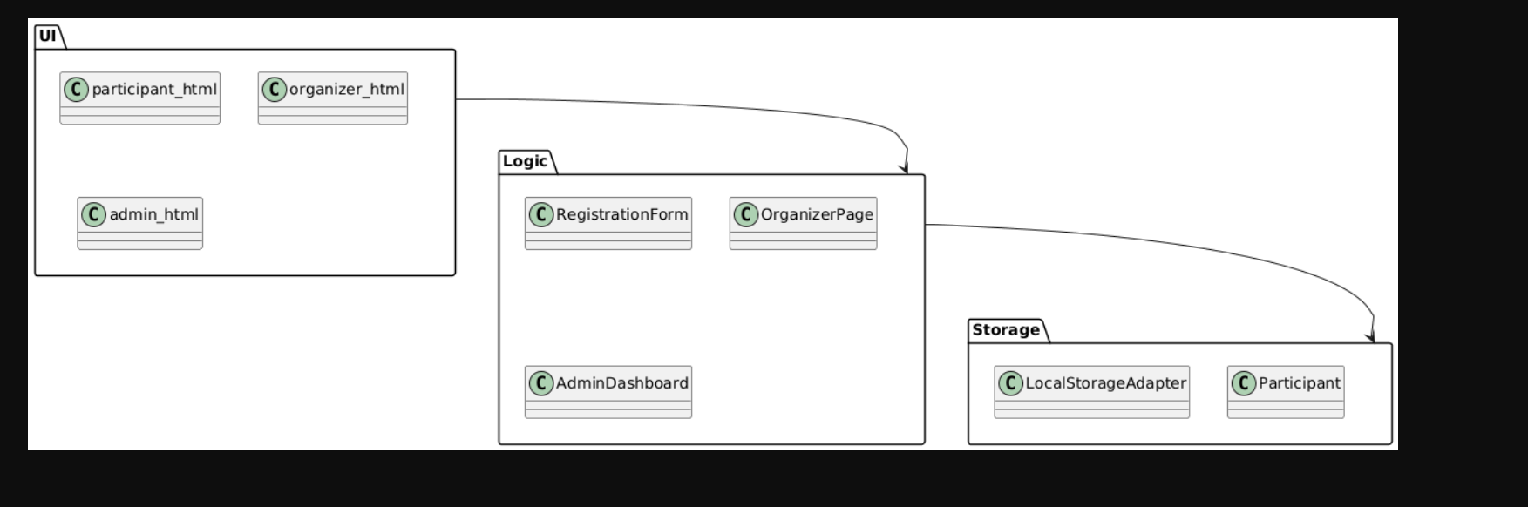
PACKAGE DIAGRAM

Slide 18

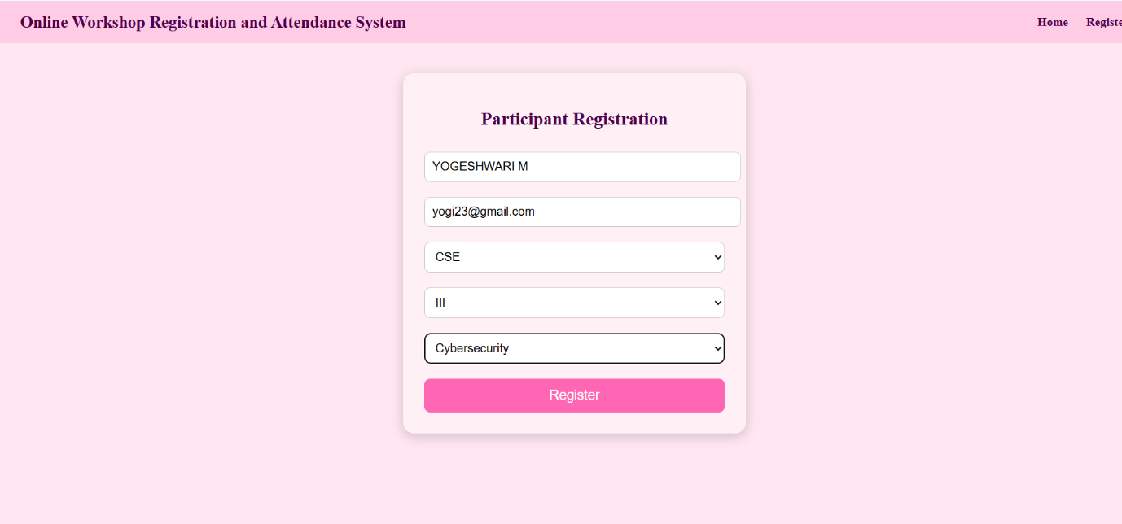
OUTPUT

Slide 19
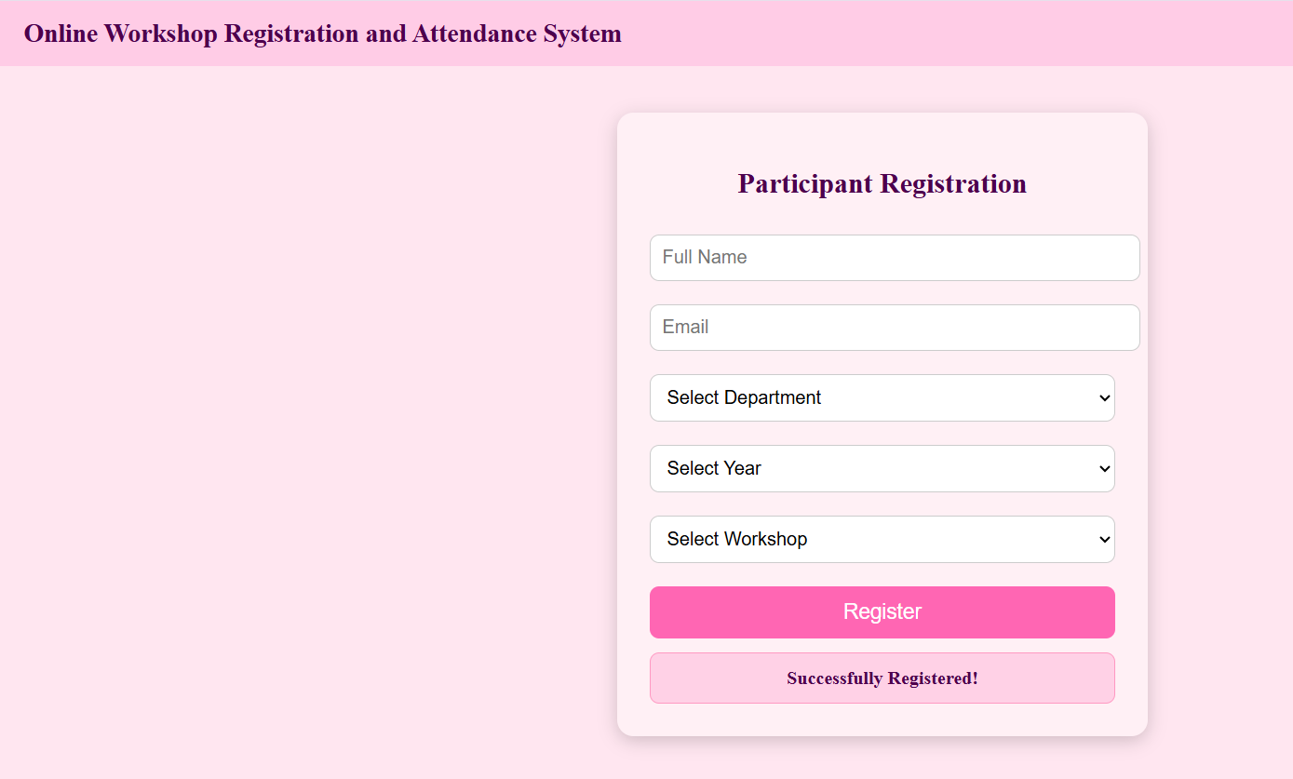
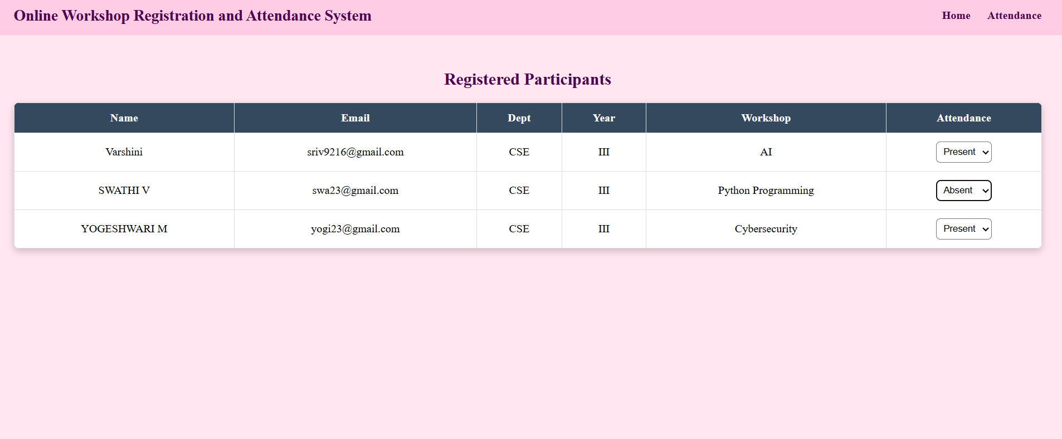
OUTPUT

Slide 20
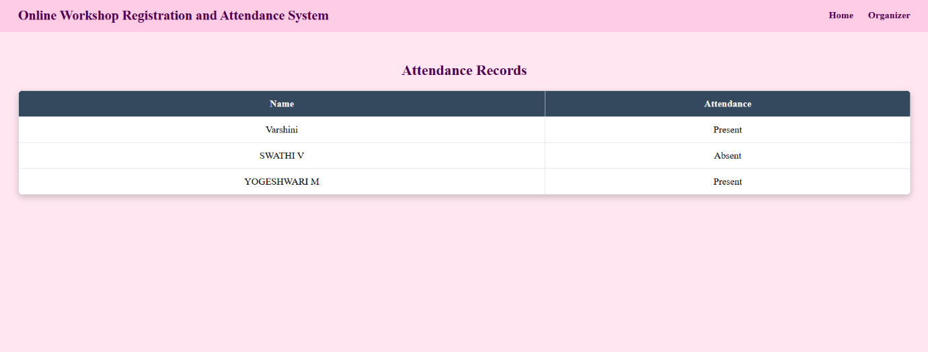
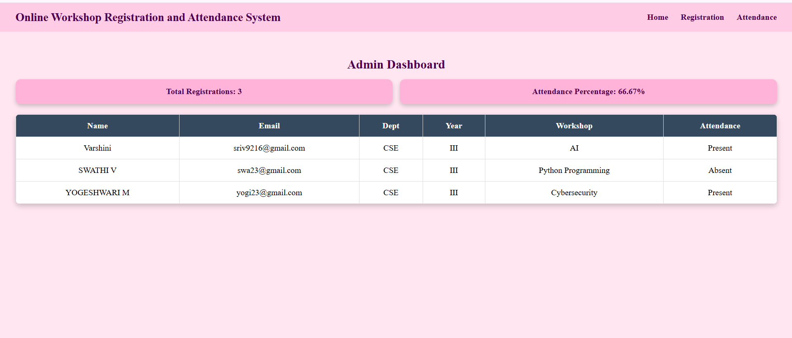
OUTPUT

Slide 21
THANK YOU

